Slide 1
Capstone Project -1
Project Title: Global Terrorism Analysis Team Members Nitesh Mishra Rohit Sharma Abhishek Verma
Aditya Dhoundiyal

Slide 2
Contents
1- Problem Statement
2- Data Summary
3- Data Analysis
4- Missing values
5- Distribution of Numerical Variables
6- Pie Charts
7- Challenges
8- Conclusion

Slide 3

Global Terrorism Analysis
The Global Terrorism Database (GTD) is an open-source database including information on terrorist attacks around the world from 1970 through 2017. The GTD includes systematic data on domestic as well as international terrorist incidents that have occurred during this time period and now includes more than 180,000 attacks. The database is maintained by researchers at the National Consortium for the Study of Terrorism and Responses to Terrorism (START), headquartered at the University of Maryland.

Slide 4
Problem Statement
. Explore the data
. Analyze the data
. Discover key findings pertaining to terrorist activities.

Slide 5
Data Summary
In this Global Terrorism Analysis dataset, there are 135 columns. Most columns contains missing values and also they are not much important. So, we are using important columns, these are iyear, imonth, iday, country_txt, provstate, region_txt, latitude, longitude, city, latitude, longitude, attacktype1_txt, nkill, nwound, gname, target1, targtype1_txt, weaptype1_txt’
The dataset ran over on terrorist attacks around the world from 1970 through 2017.

Slide 6
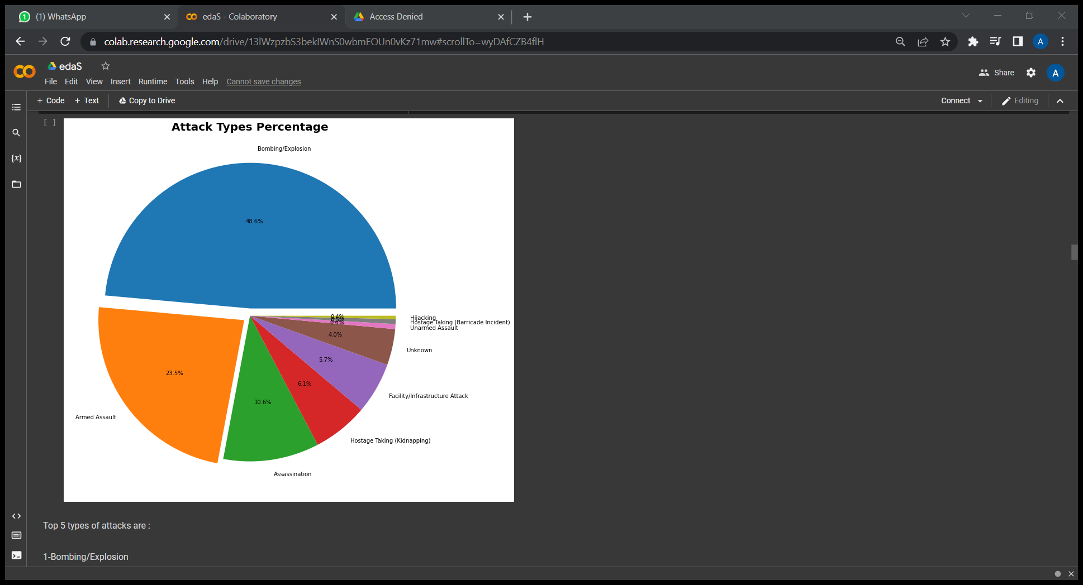
Different Types of Attacks
Top 5 types of attacks are :

Slide 7
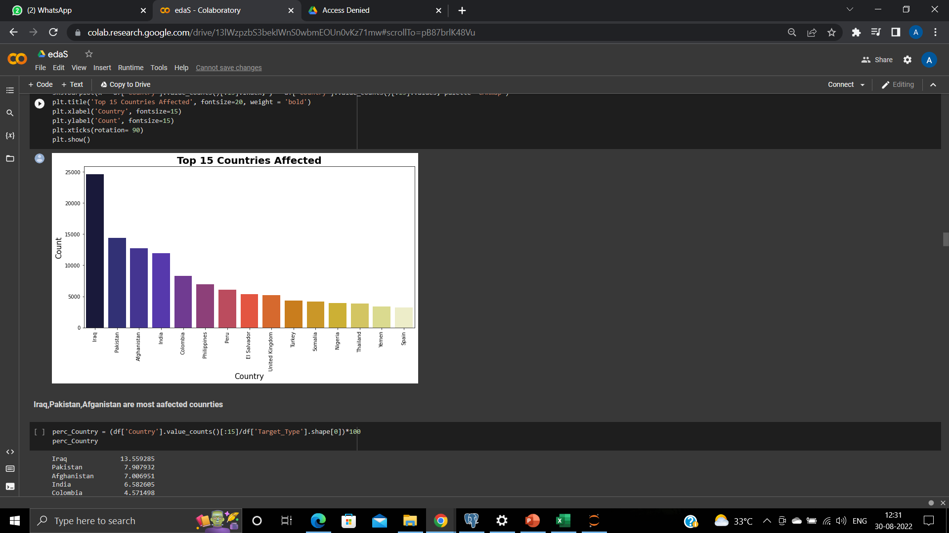
Top 15 Countries with most attacks

Slide 8
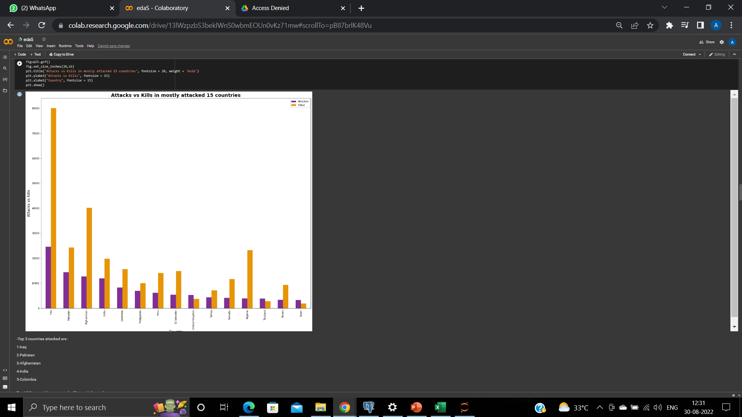
Comparing No. of Attacks with Killings for top 15 countries

Slide 9
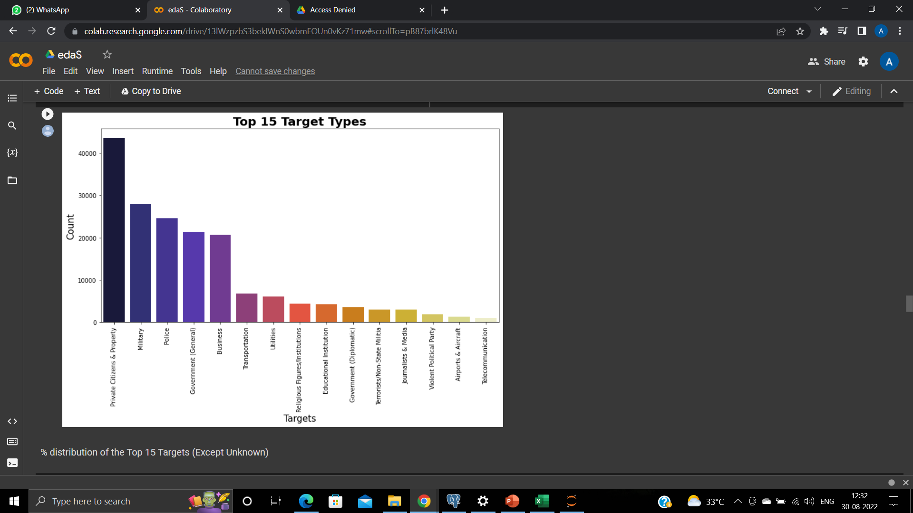
Top 15 Target Types

Slide 10
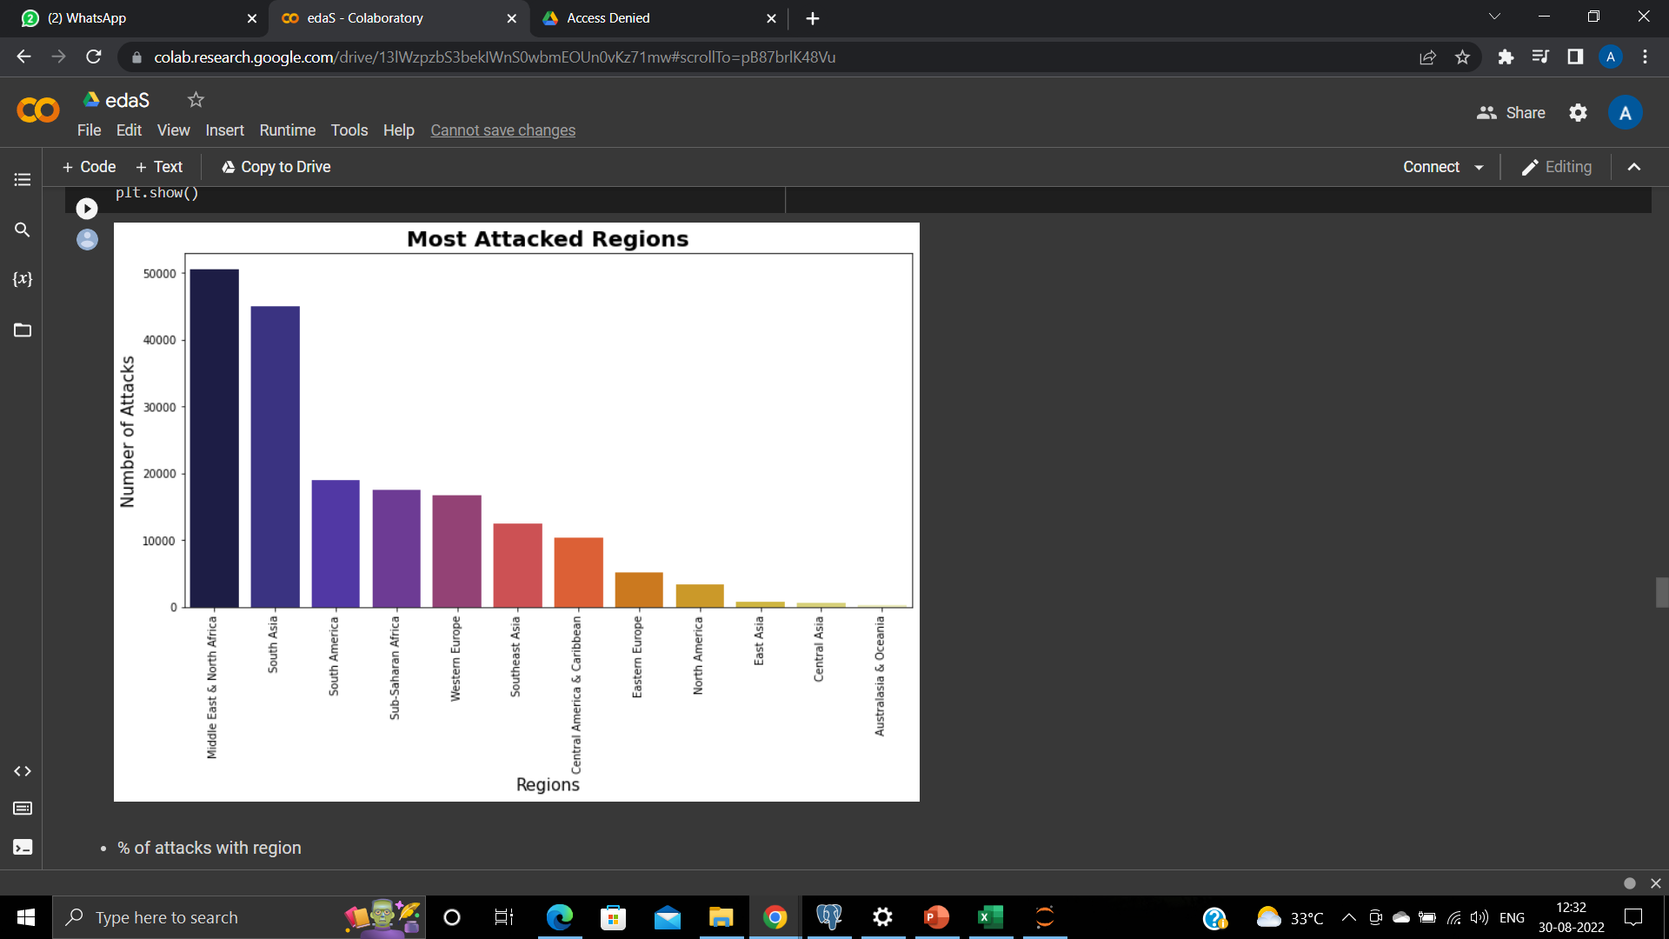
Most Attacked Regions

Slide 11
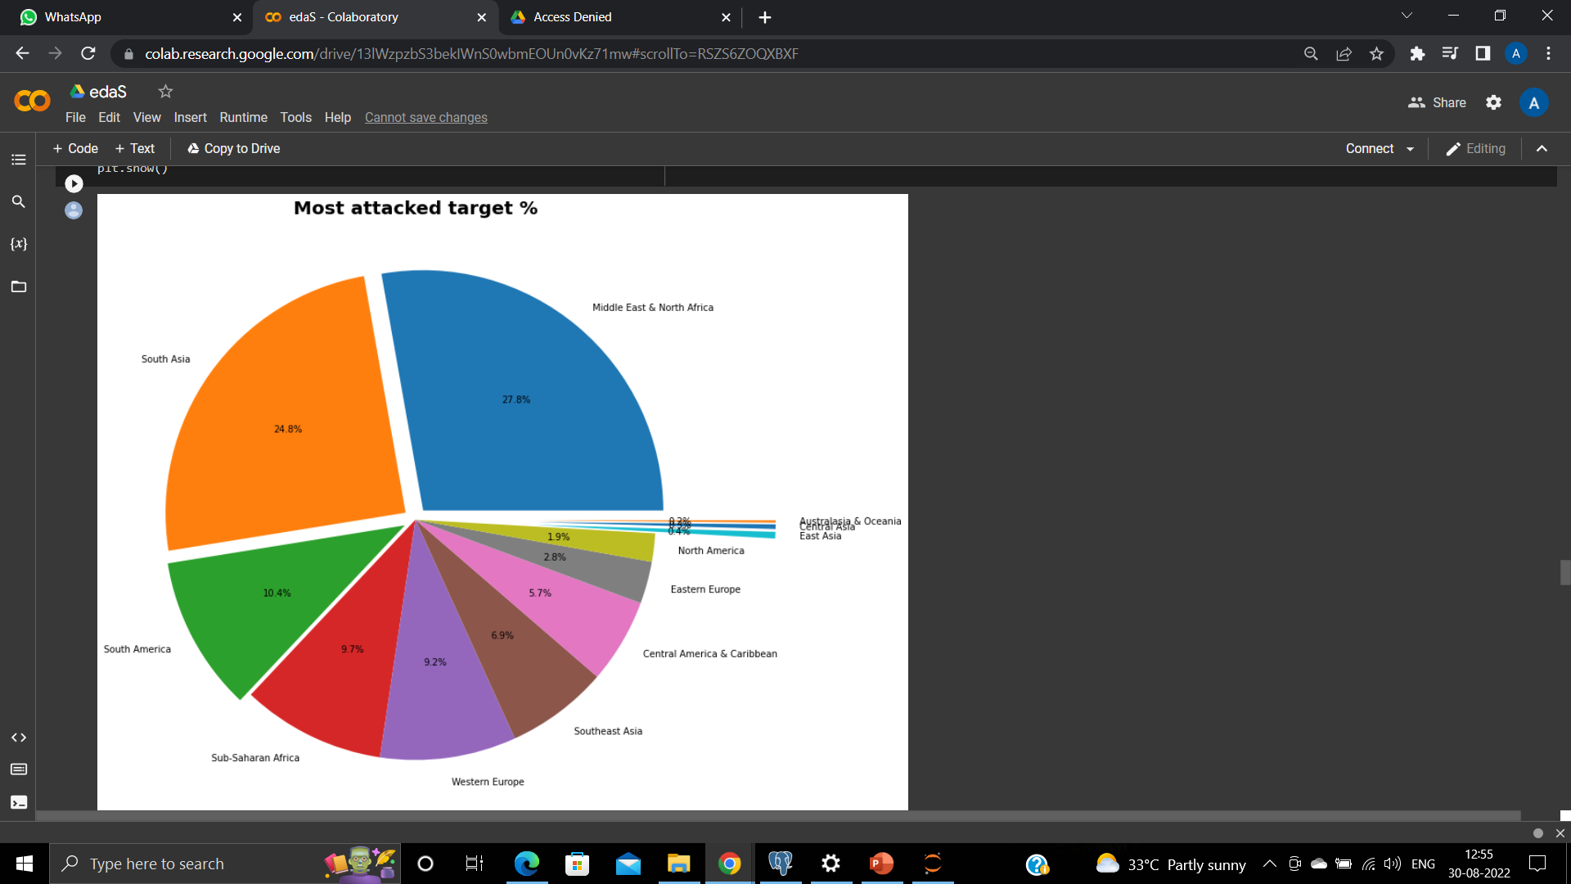
Percentage of attacks with region

Slide 12
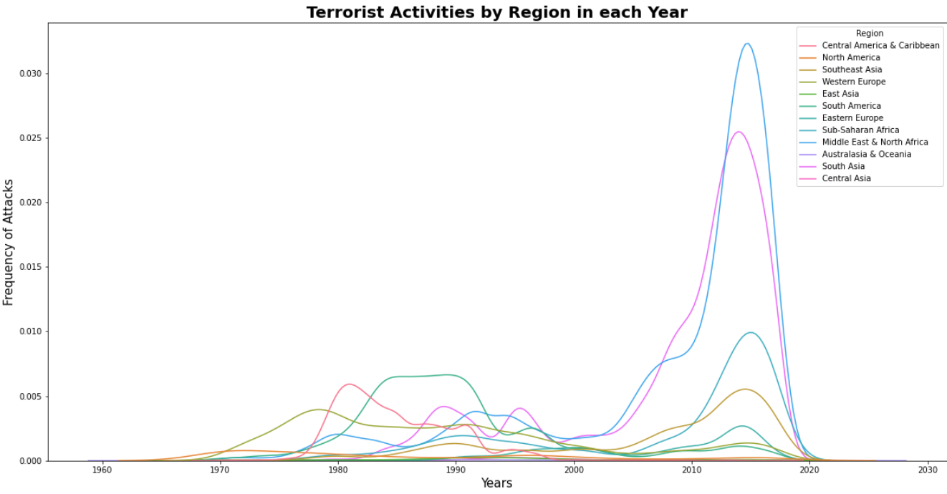
Terrorist Activities by Region in Each Year

Slide 13
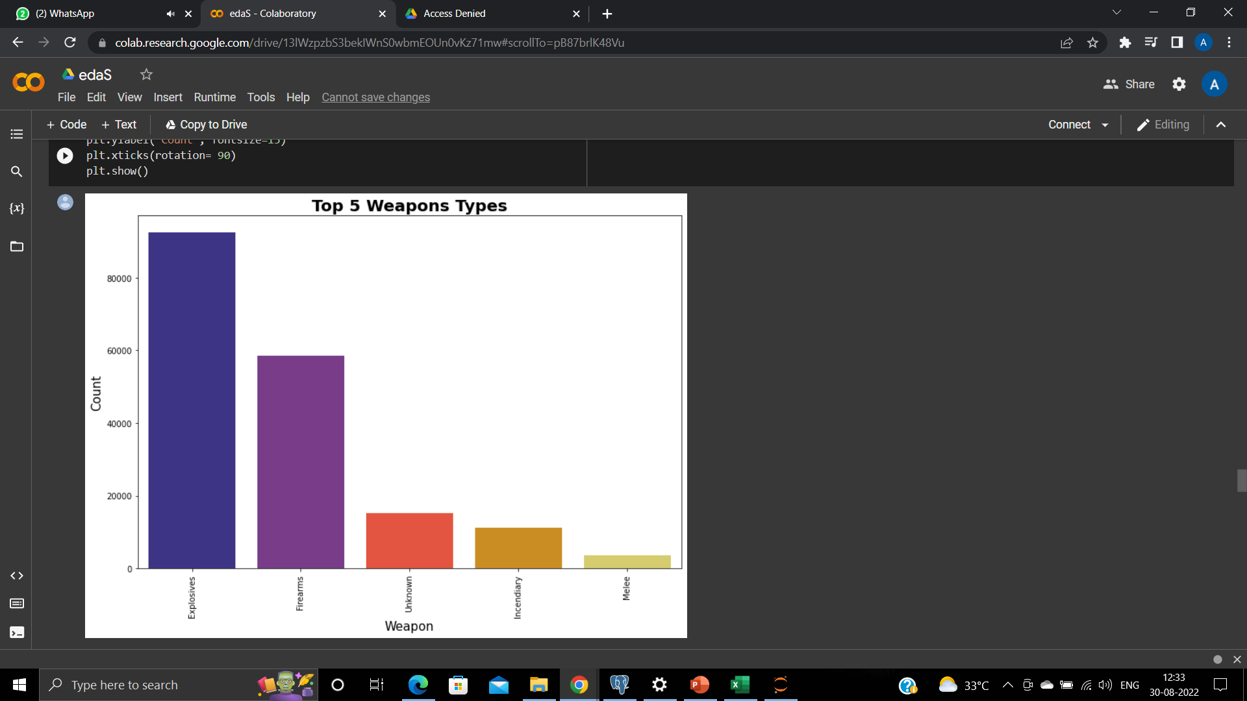
Top 5 Weapons Types

Slide 14
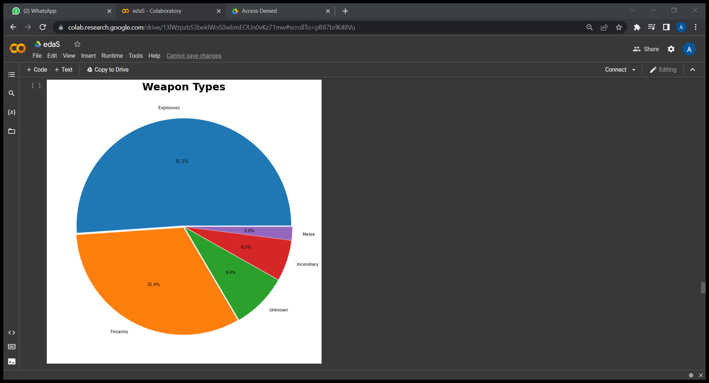
Percentage of Weapon Types

Slide 15
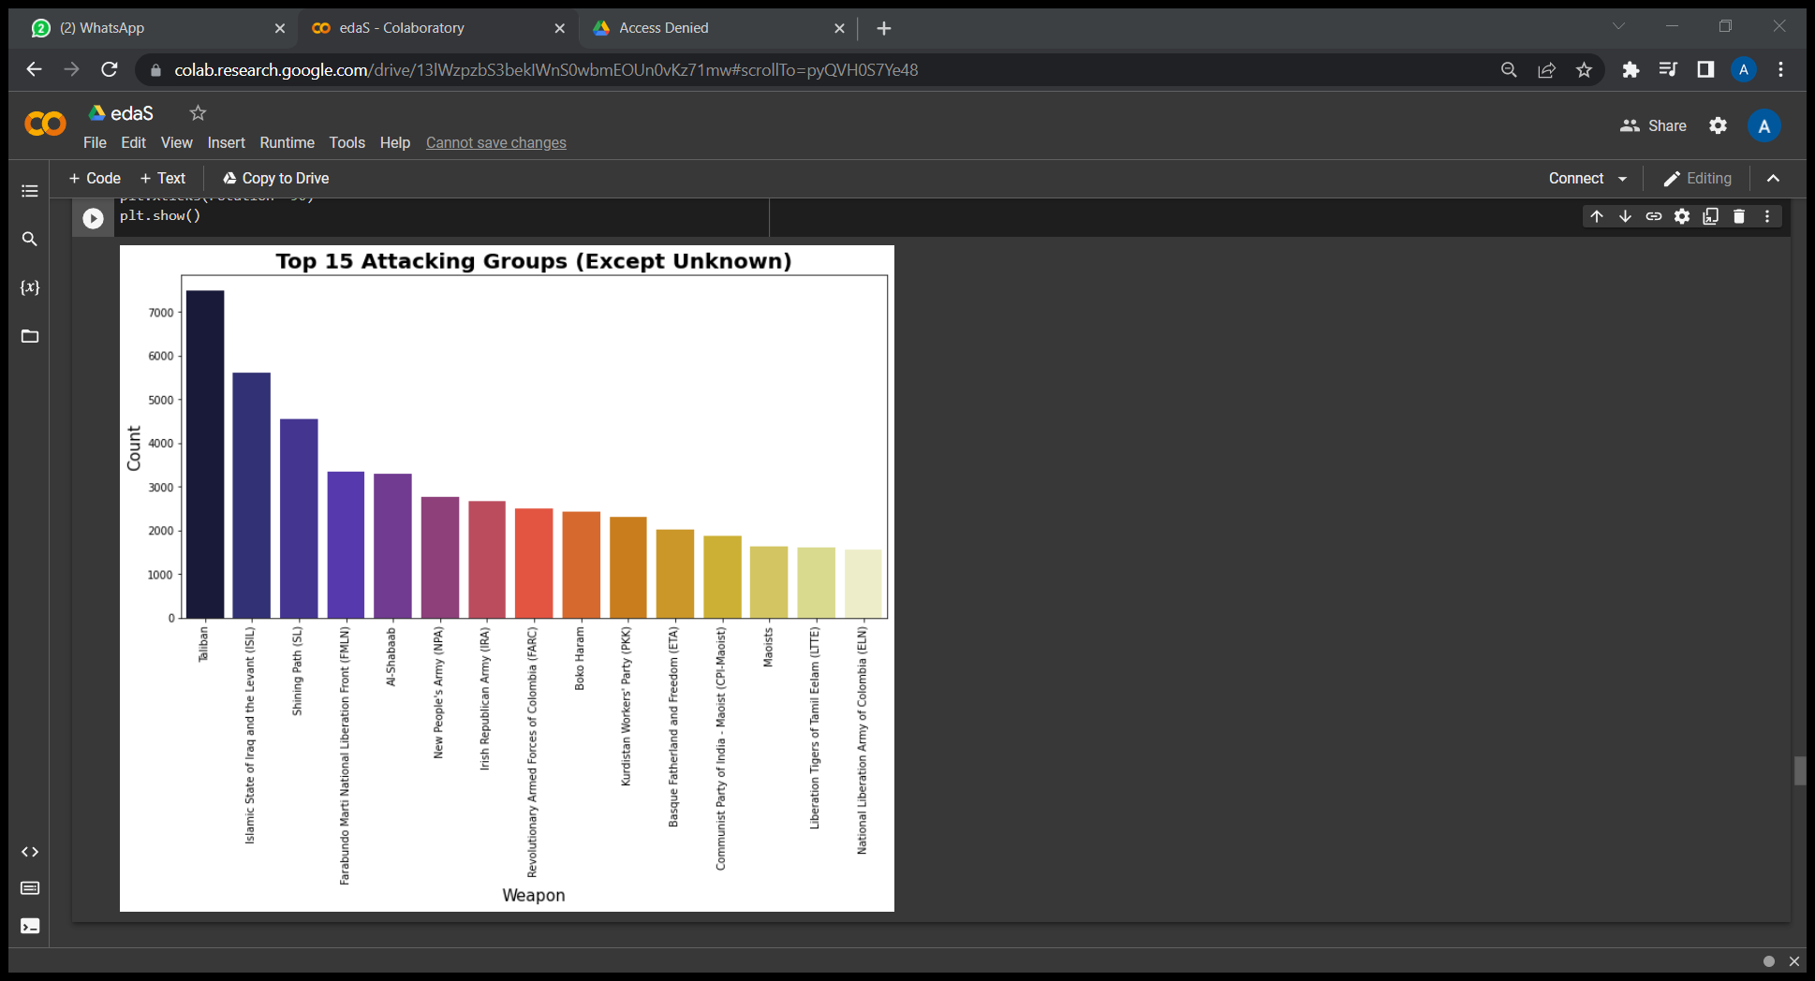
Top 15 Attacking Group

Slide 16
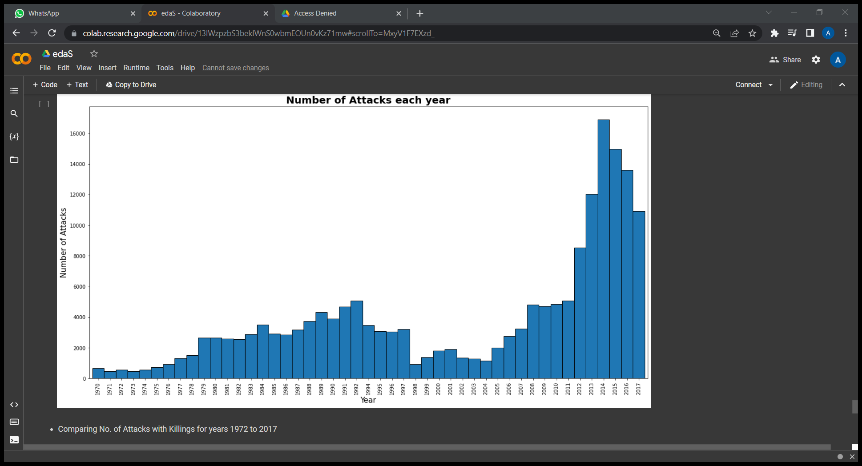
Numbers of Attack per Year

Slide 17
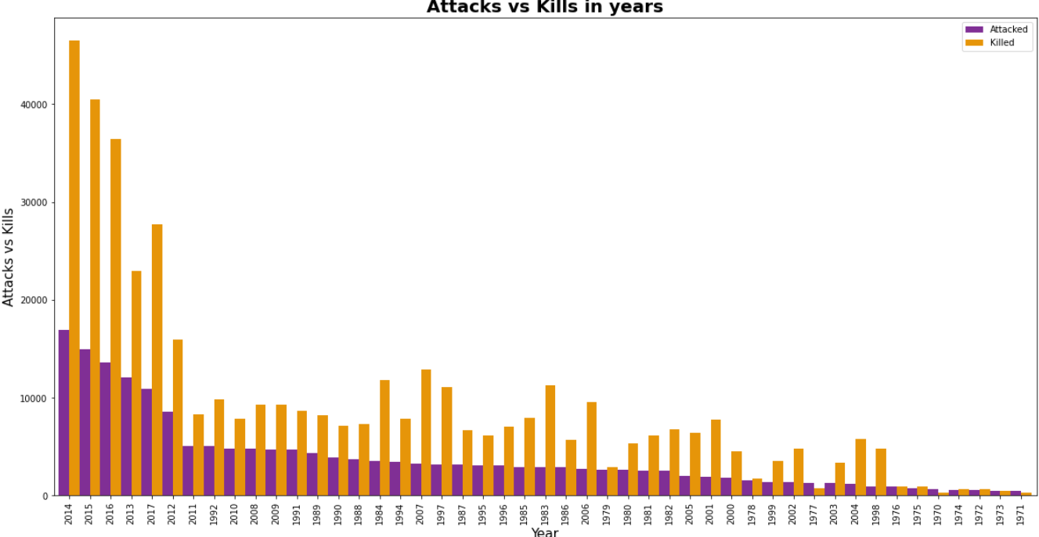
Attack vs Kills in per Year

Slide 18
Challenges

Slide 19
Conclusion

Slide 21


Slide 22
Q & A

